Slide 1
Machine Learning
ENSIIE - 2023
Supervised Learning

Slide 2
Supervised Learning

Slide 3
Supervised Learning ?
GOAL : Make prediction based on experience
Experience : Data + Feedback

Slide 4

Supervised Learning ?

Slide 5
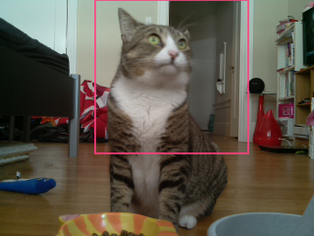
Supervised Learning ?

Slide 6


Supervised Learning ?
Notes:
Probabilistique

Slide 7
OUT OF SCOPE
Input is speech or pictures
In depth Deep Learning

Slide 8
Let’s start with a simple and naive example

Slide 9



Example
Our goal : predict if a moth is a luna moth or an emperor moth

Slide 10
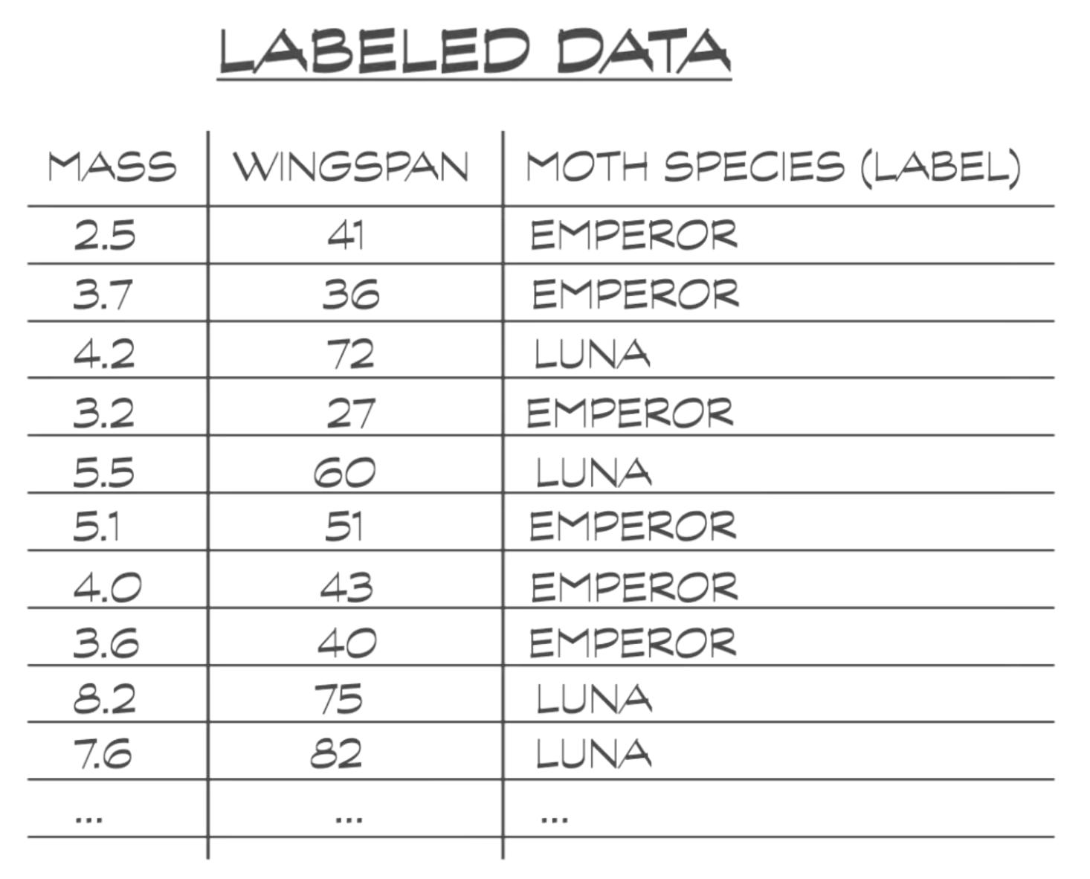
Example

Slide 11
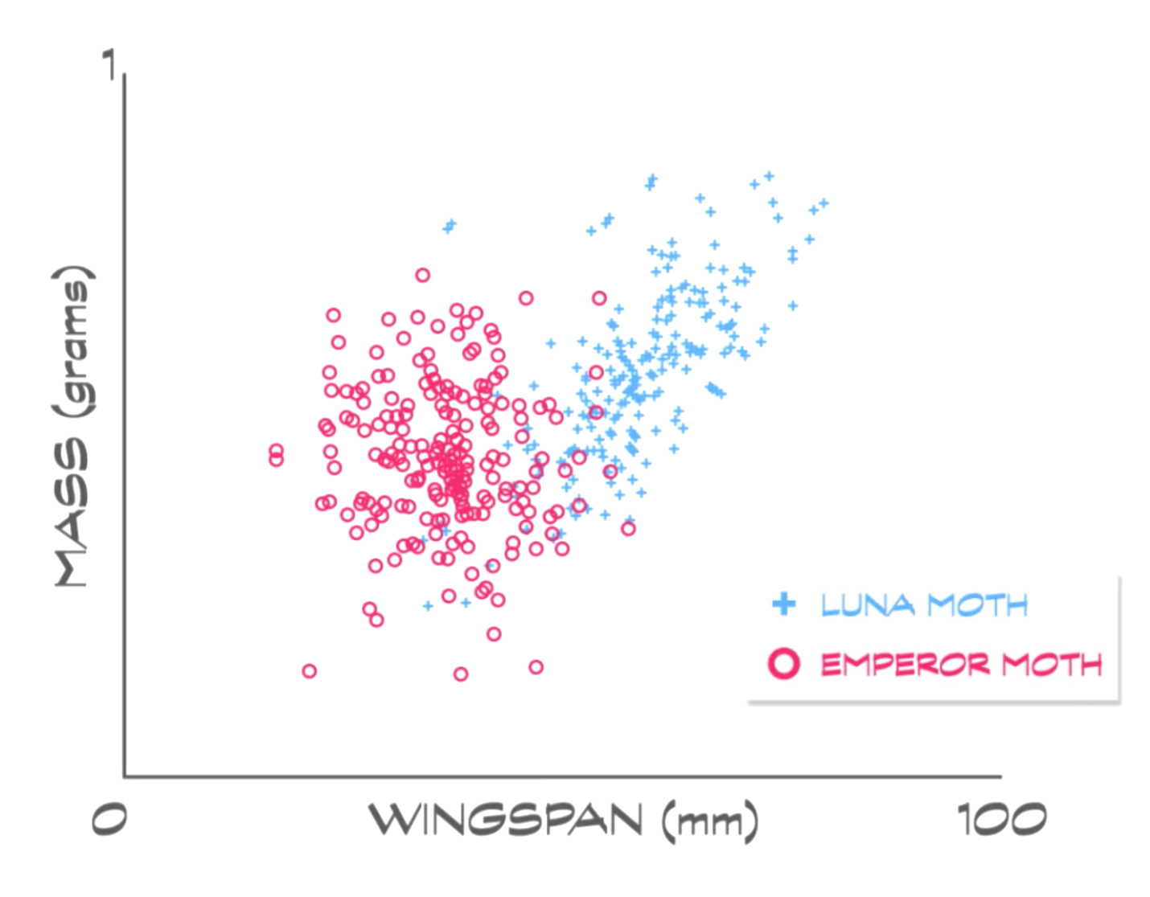
Example

Slide 12
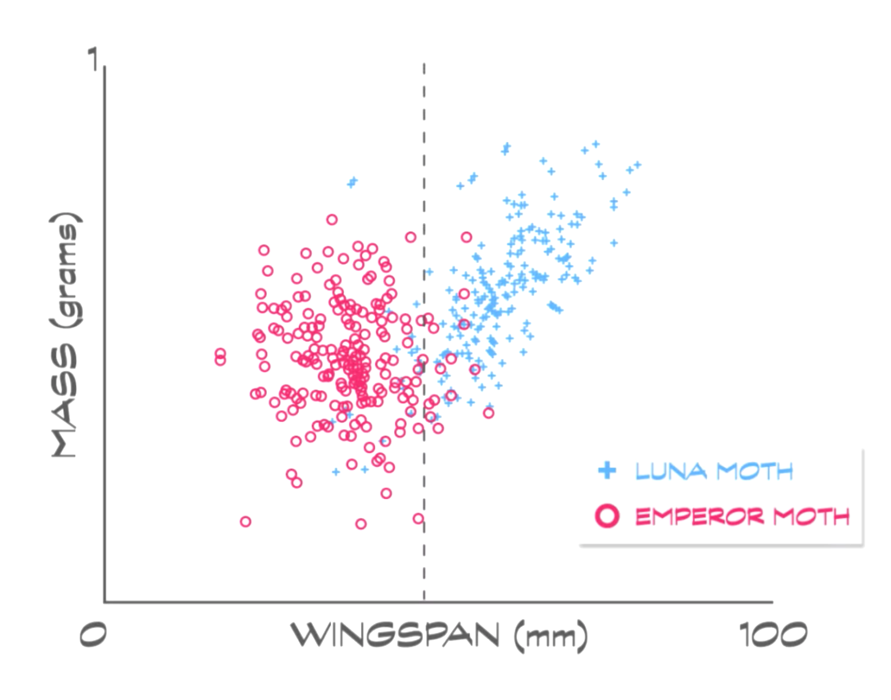
Example - first strat

Slide 13
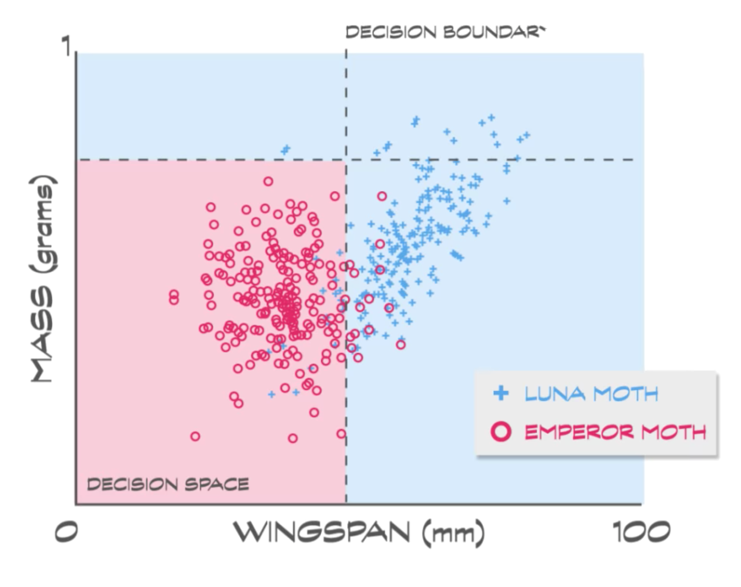
Example - first strat

Slide 14
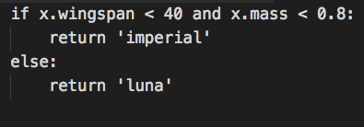
Example - first strat
Success : 80%
Too dependant on effective wingspan and mass

Slide 15
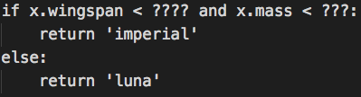

Example - first strat
given a classified population

Slide 16
Example - second strat
Mass(x) = -k Wingspan(x) + p

Slide 17
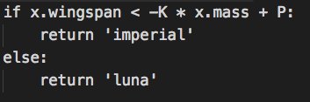
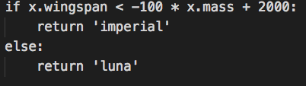
Example - second strat
given a classified population
Success : 82 %

Slide 18
Example - strat battle

Slide 19
Strategy is related to data structure and quantity

Slide 20
What we have seen
We need to have a strategy - AKA model
We need to have a data structured in a way the model can manipulate it - AKA Features
We need to optimize the model thanks to the labelled data - AKA training

Slide 21
A Machine Learning pipeline
Labelled Data
Feature store
Model management
Model training
Unlabelled Data
Prediction

Slide 22
Feature extraction

Slide 23
Feature extraction - Motivation
All models needs matrix
Goal : transform a multi typed dataset (with missing values) in a beautiful matrix
Wingspan | Mass | Color | Last seen
25 | 0.7 | red | 02/01/2018
40 | 0.3 | red blue | 02/01/2017
50 | 0.5 | purple | 02/23/2018
Wingspan | Mass | is red | is blue | is purple | seen last year | seen last month
25 | 0.7 | 1 | 0 | 0 | 0 | 1
40 | 0.3 | 1 | 1 | 0 | 1 | 0
50 | 0.5 | 0 | 0 | 1 | 1 | 0

Slide 24
Feature extraction - Deal with non numeric values
Enum like non ordered -> dimension split
Color
red
blue
red blue
is red | is blue
1 | 0
0 | 1
1 | 1
Enum like ordered -> non ordered + numeric transform
Impression
Love it
Like it
no idea
don't like it
Impression
5
4
3
2

Slide 25
Feature extraction - Deal with non numeric values
Text -> Text mining
Date -> check if it’s an autoregression problem with new “legacy” feature + ordered

Slide 26
Feature extraction - Deal with numeric values
Ensure the numeric has an ordered meaning
Adapt the scale (logarithmic for big values)
Do nothing

Slide 27
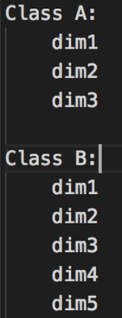
Feature extraction - Deal with missing values
Find an underlying model
Complete with other data (by distance or supervised learning)
Drop the dimension
Split in two problems - one feeding another
A
B

Slide 28
Feature extraction - Dimension reduction
Spectral Analysis / PCA / Kernel approximation
Unsupervised learning
Drop the dimension

Slide 29
A Machine Learning pipeline
Labelled Data
Feature store
Model management
Model training
Unlabelled Data
Prediction

Slide 30
Model management
choosing your model

Slide 31
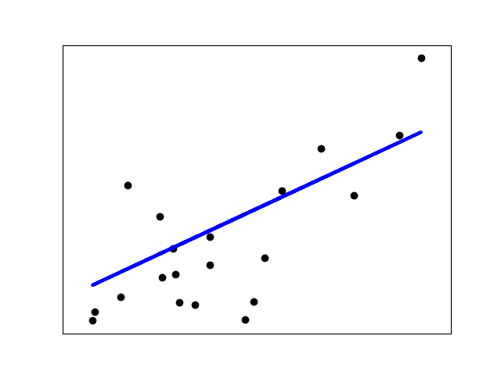
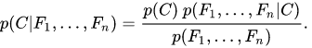

Generalized Linear models
Linear regression
Logistic regression
Naive bayes classification
Support Vector Machine

Slide 32
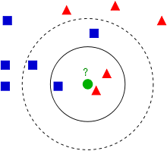
Nearest neighbors
Only if you have a valid distance !
By Radius or by nb Neighbors

Slide 33
Decision Trees
Wingspan
<40
Mass
>40
<0.8
Imperial
>0.8
Luna
Luna
Good visibility on dimension importance
help for feature extraction
Interpolation based on simple fonction

Slide 34
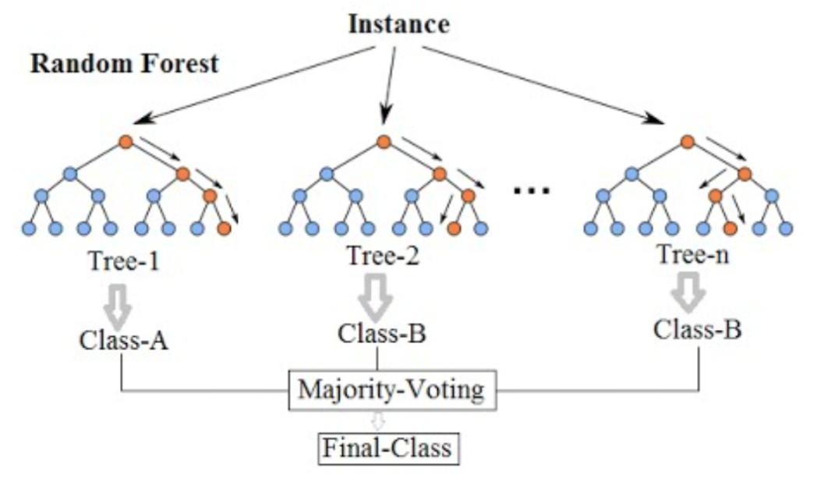
Random Forest
Map Reduce
More accurate than decision tree - but heavier computation load & less comprehensible

Slide 35
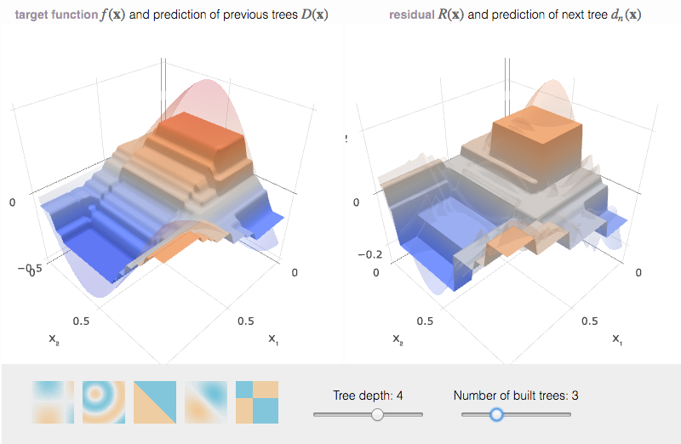
Trees and so on...
Gradient boosting
Extreme Gradient Boosting
Ada boost
...

Slide 36
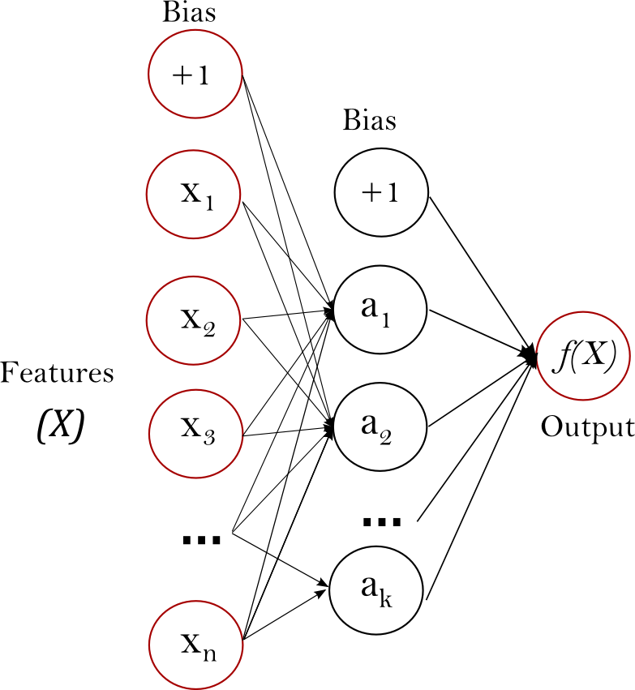
Neural net
ai = wi1.x1 + … + wik.xk
bi = w’i1.fa(a1) + … + w’ik.fa(ak) ...
Composition / Backpropagation & activation function
Beats trees with sufficient datas
Time consuming
Complexity ! O(n m h^k)

Slide 37
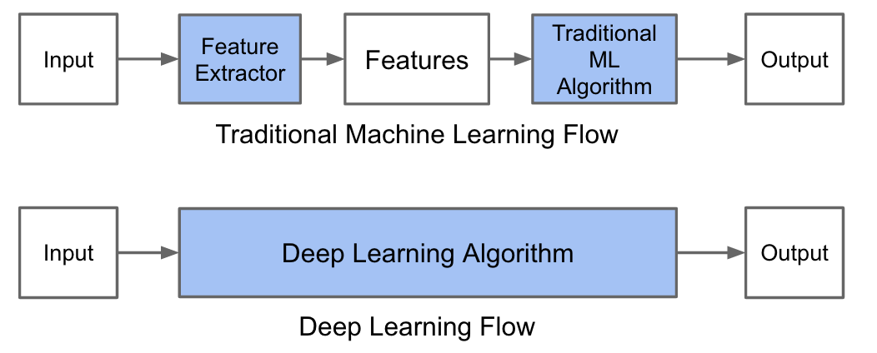
Deep learning - love / hate
Who has enough data ?
Who has time to train ?

Slide 38
Model management
tuning your model

Slide 39
Hyperparameter Optimization
Each model needs to be tuned…
Random forest : nb trees, nb features, split by feature...
Neural Net : alpha, nb layer, activation function…
...
Each tuning has to be done in a certain order

Slide 40
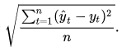
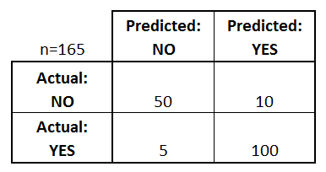
A testing strategy
Split randomly your data in two sets - A & B
Train your model on A
Check the quality on B
RMSE Confusion Matrix
AUC...

Slide 41
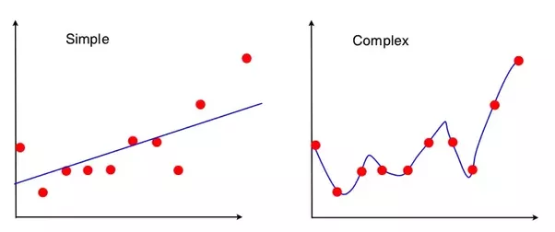
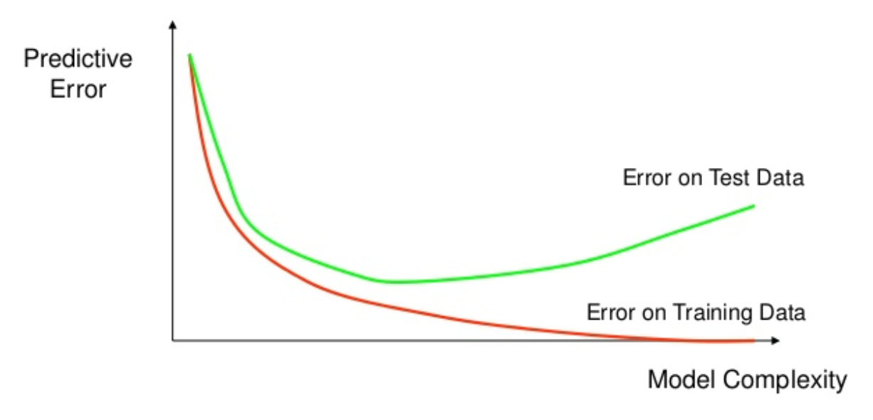
Beware of overfitting !

Slide 42





Supervised learning - on the tech side
Python : sklearn
Tensorflow
Keras / Theano
MXNet
R : e1071, rpart (trees), nnet (neural),
randomForest, glmnet (Lasso),...
Spark : Spark/MLLib

Slide 43
Supervised learning and so on...
From model to feature to model to feature to…
Your time is the limit

Slide 44
Questions ?

